Slide 1
TN211: Computer Networking Protocols
Transport Layer Protocols
CN211 CIVE 2018/19

Slide 2
Transport Layer Protocols
  There are two fundamental protocols:
  Transmission Control Protocol (TCP): connection-oriented protocol
  User Datagram Protocol (UDP): connectionless protocol
  Connection-oriented communication: establishes a logical (virtual) connection prior to sending data.
  Connectionless communication: sends data right away without establishing a logical connection.
CN211 CIVE 2018/19

Slide 3
Transport Layer Protocols
  Why Transport Layer Protocols?
  IP provides a weak, but efficient service model (best-effort)
    Packets can be delayed, dropped, reordered, duplicated
    Packets have limited size (why?)
  IP packets are addressed to a host
    How to decide which application gets which packets?
CN211 CIVE 2018/19

Slide 4
Transport Layer Protocols
  Why Transport Layer Protocols
  How should hosts send into the network?
    Flow Control
    Too fast is bad; too slow is not efficient
CN211 CIVE 2018/19

Slide 5

Types of Data Deliveries
  The transport layer is responsible for process-to-process delivery.
CN211 CIVE 2018/19

Slide 6
Ports
  Since there are many applications running on a computer, there is a need to decide which application gets which packet.
  A port number is a way to identify a specific application (process) to which an Internet or other network message is to be forwarded when it arrives at a server.
  It is essentially a memory space denoted by a 16-bit non-negative integer ranging from 0-65,535 inclusive.
CN211 CIVE 2018/19

Slide 7

Ports..
  One port is linked to only one application.
  One application may use many ports for different purposes (e.g. FTP: 20, 21)
  Port numbers can be categorized into 3:
  Well-known Ports: range 0-1023
  Registered Ports: range 1024-49151
  Dynamic ports: range 49152-65535
CN211 CIVE 2018/19

Slide 8
Well-Known Ports
  These ports are reserved for services and applications.
  Everyone agrees what services run on these ports. E.g. ssh:22, http:80
  By defining these well-known ports for server applications, client applications can be programmed to request a connection to that specific port and its associated service.
  Client must know server’s port.
  The Well Known Ports are assigned by the IANA and on most systems can only be used by system (or root) processes or by programs executed by privileged users.
CN211 CIVE 2018/19

Slide 9
Registered Ports
  These port numbers are assigned to user processes or applications.
  These processes are primarily individual applications that a user has chosen to install rather than common applications that would receive a Well Known Port.
  Used for non-common applications.
  When not used for a server resource, these ports may also be used dynamically selected by a client as its source port.
CN211 CIVE 2018/19

Slide 10
Dynamic Ports
  Also known as Ephemeral Ports
  Usually assigned automatically to client applications when initiating a connection.
  May be used as client’s source port or server’s destination port
  In practice, it may also include the range of Registered Ports (Numbers 1024 to 49151)
CN211 CIVE 2018/19

Slide 11
Socket
  A socket is one endpoint of a two-way communication link between two programs running on the network.
  The endpoint is a combination of an IP address and a port number and transport layer protocol (usually TCP).
  Every TCP connection can be uniquely identified by its two endpoints.
  That way you can have multiple connections between your host and the server.
  It is bound to a port number so that the TCP layer can identify the application that data is destined to be sent to.
CN211 CIVE 2018/19

Slide 12
Port Implementation
Typically, a port is implemented by OS as a message queue:
  Incoming messages added to queue for specified port.
  Messages removed by application when it reads the port
  Messages discarded if queue is full
  Process blocks if queue is empty when it reads
CN211 CIVE 2018/19

Slide 13
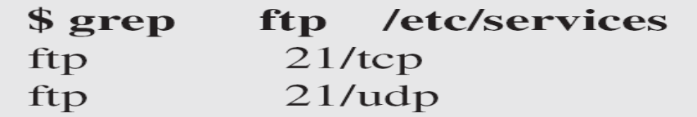
Obtaining Port Numbers-Linux Systems
Need host IP and port to talk to server
  Once server has address, it can respond to address in packet it received
Different techniques for getting port #
  Use a well-known port (i.e. DNS uses 53).
  Values found in /etc/services for Linux Systems.
  Use a port mapper–single process that runs on the server and knows the ports for different services.
  Use a directory service that runs on the network and knows the port numbers for services on any host.
CN211 CIVE 2018/19

Slide 14
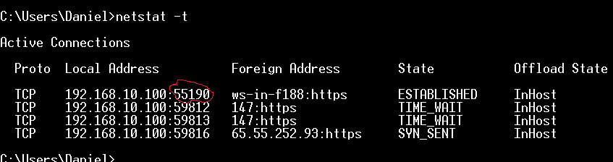
Obtaining Port Numbers-Windows Systems
Open command prompt and enter netstat command:
  Use option u for open UDP ports
  Option t for open TCP ports
CN211 CIVE 2018/19

Slide 15
UDP
  It is a connectionless protocol:
  Provides a way to send IP datagrams without establishing a connection.
  Same best-effort service model as IP.
  Only adds multiplexing and de-multiplexing capability to basic best-effort delivery provided by IP.
  Minimalist protocol with messages of up to 64KB.
  Needs to identify target process for message/datagram
  Could use some direct identifier like process ID, but that might not work with all OSes.
  Instead uses indirect handle, the port number.
CN211 CIVE 2018/19

Slide 16
Well-Known Ports Used with UDP
Port | Protocol | Description
7 | Echo | Echoes received datagram back to the sender
9 | Discard | Discard any datagram that is received
11 | Users | Active users
13 | Daytime | Returns the date and the time
17 | Quote | Returns quote of the day
19 | Chargen | Returns a string of characters
53 | Domain | Domain Name Service
67 | Bootps | Server port to download bootstrap information
CN211 CIVE 2018/19

Slide 17
Well-Known Ports Used with UDP..
Port | Protocol | Description
68 | Bootpc | Client port to download bootstrap information
69 | TFTP | Trivial File Transfer Protocol
111 | RPC | Remote Procedure Call
123 | NTP | Network Time Protocol
161 | SNMP | Simple Network Management Protocol
162 | SNMP | Simple Network Management Protocol (Trap)
520 | RIP | Routing Information Protocol
CN211 CIVE 2018/19

Slide 18

UDP Header Format
CN211 CIVE 2018/19

Slide 19
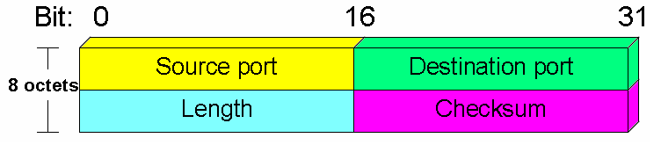
UDP Header Format
Source port:
  Uses 2 Bytes=16Bits
  UDP port of the sending host.
  The sending port value is optional.
  If not used, it is set to zero.
CN211 CIVE 2018/19

Slide 20
UDP Header Format
Destination port:
  Uses 2 Bytes=16Bits
  UDP port of destination host.
  This provides an endpoint for communications.
CN211 CIVE 2018/19

Slide 21
UDP Header Format
Length:
  Uses 2 Bytes=16Bits.
  Refers to the size of the UDP message.
  The minimum UDP packet contains only the header information (8 bytes).
  UDP length includes header and data.
  UDP length = IP length – IP header’s length
CN211 CIVE 2018/19

Slide 22
UDP Header Format
Checksum:
  Uses 2 Bytes=16Bits.
  Verifies that the header is not corrupted.
  The checksum value is optional in IPv4, required in IPv6.
  If not used, it is set to zero.
  It is the same algorithm used for TCP and IP.
CN211 CIVE 2018/19

Slide 23
UDP Header Format
Checksum:
  If an error is detected, the entire UDP segment is discarded and no further action is taken.
  It is computed over message data, UDP header, and pseudo-header–protocol number and source and destination IP addresses, plus UDP length.
CN211 CIVE 2018/19

Slide 24
Checksum Calculation of a Simple UDP User Datagram
Next slide shows the checksum calculation for a very small user datagram with only 7 bytes of data.
  Because the number of bytes of data is odd, padding is added for checksum calculation.
  The pseudoheader as well as the padding will be dropped when the user datagram is delivered to IP.
CN211 CIVE 2018/19

Slide 25

Checksum Calculation of a Simple UDP User Datagram
Source Port
Dest. Port
Length
D. Checksum
CN211 CIVE 2018/19

Slide 26
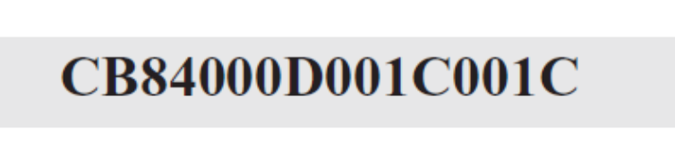
Example of Lab Work and Tutorial..
Suppose following is a dump of a UDP header in hexadecimal format:
The source port number is the first four hexadecimal digits (CB84)₁₆ or 52100.
The destination port number is the second four hexadecimal digits (000D)₁₆ or 13.
The third four hexadecimal digits (001C)₁₆ define the length of the whole UDP packet as 28 bytes.
CN211 CIVE 2018/19

Slide 27
Example of Lab Work and Tutorial..
Suppose following is a dump of a UDP header in hexadecimal format:
The length of the data is the length of the whole packet
minus the length of the header, or 28 – 8 = 20 bytes.
Since the destination port number is 13 (well-known port), the packet is from the client to the server.
The client process is the Daytime
CN211 CIVE 2018/19

Slide 28
Example of Lab Work and Tutorial
Suppose following is a dump of a UDP header in hexadecimal format:
CB480045001C001C
  What is the source port number?
  What is the destination port number?
  What is the total length of the user datagram?
  What is the length of the data?
  Is the packet directed from a client to a server or vice versa?
  What is the client process?
CN211 CIVE 2018/19

Slide 29
When is the Use of Connectionless Service Justified?
  Inward data collection:
  Periodic active or passive sampling of data sources, such as sensors, and automatic self-test reports from security equipment or network devices.
  In a real-time monitoring situation, the loss of an occasional data unit would not cause distress, because the next report should arrive shortly.
  Outward data dissemination:
  Broadcast and multicast messages to network users, the announcement of a new node or the change of address of a service, and the distribution of real-time clock values.
CN211 CIVE 2018/19

Slide 30
When is the Use of Connectionless Service Justified?
  Request-response:
  Applications in which a transaction service is provided by a common server to a number of distributed TS users, and for which a single request-response sequence is typical.
  Use of the service is regulated at the application level, and lower-level connections are often unnecessary and cumbersome.
Real-time applications:
  ..such as voice and telemetry, involving a degree of redundancy and/or real-time transmission requirement.
  These must not have connection-oriented functions such as retransmission.
CN211 CIVE 2018/19

Slide 31



Popular Applications That Use UDP
Multimedia streaming
  Retransmitting lost/corrupted packets is not worthwhile
  By the time the packet is retransmitted, it’s too late
  E.g., telephone calls, video conferencing, gaming
Simple query protocols like Domain Name System
  Overhead of connection establishment is overkill
  Easier to have application retransmit if needed
“Address for www.cnn.com?”
“12.3.4.15”
CN211 CIVE 2018/19

Slide 32
UDP Case Studies
DHCP – Dynamic Host Configuration Protocol
  TCP connection is impossible
    We don't have an IP address yet!
DNS – Domain Name System
  TCP connection is too expensive
    Everybody on the planet talks to root name servers
    That would be a lot of kernel socket buffers!
  TCP connection expense is wasteful
    TCP connection costs 5 packets (2 RTT) by itself
    DNS query/response needs only 2 packets, 1 RTT
CN211 CIVE 2018/19

Slide 33
UDP Case Studies
NTP – Network Time Protocol
  Setting your clock requires estimating latency to peer
  TCP buffering interferes with estimation
TFTP
  TCP implementation is too expensive
    Boot code in BIOS...size is limited
CN211 CIVE 2018/19

Slide 34
UDP Case Studies
SNMP – Simple Network Management Protocol
  TCP connection is too expensive
    Workgroup router can't afford connection state...
    ...would be easy denial-of-service attack
Kerberos, Zephyr
  Like DNS: many clients, request/response pattern
  TCP connection is too expensive & wasteful
CN211 CIVE 2018/19

Slide 35
UDP Case Studies
AFS - “Andrew File System” (or not)
  Counts as “experimental transport protocol”
  In 1980's, many TCP implementations had poor throughput
  Easier to implement a similar protocol than to fix kernels
  Unclear what the “right” answer is
NFS – Sun's “Network File System”
  Similar reasons, judgement to AFS
  Lots of people run NFS over TCP
CN211 CIVE 2018/19

Slide 36
UDP Case Studies
RPC (Remote Procedure Call) libraries
  SunRPC, CORBA, DCOM, etc.
  Many operate over both UDP and TCP
  Application often selects via flag
    Application, not library, knows how many calls to same server
Special-purpose communications
  Examples:
    ISIS distributed-computation library
    IP multicast
  Communication pattern isn't point-to-point
CN211 CIVE 2018/19

Slide 37
UDP Advantages
Finer control over what data is sent and when
  As soon as an application process writes into the socket.
  … UDP will package the data and send the packet.
No delay for connection establishment
  UDP just blasts away without any formal preliminaries.
  … which avoids introducing any unnecessary delays.
CN211 CIVE 2018/19

Slide 38
UDP Advantages..
No connection state:
  No allocation of buffers, parameters, sequence #s, etc.
  … making it easier to handle many active clients at once.
Small packet header overhead:
  UDP header is only eight-bytes long.
CN211 CIVE 2018/19

Slide 39
UDP Disadvantages
There is no congestion control, meaning that bottlenecks build up to the point that no traffic can be transmitted.
UDP is unreliable-data may be dropped or arrive out of order and provides no acknowledgement.
CN211 CIVE 2018/19

Slide 40
Scanning UDP Protocols
Scanning UDP can be Frustrating.
  A UDP packet that reaches a server port which is open replies with nothing
  A UDP packet that reaches a server port which is closed replies with an ICMP type 3 message that the service is not reachable
  A UDP packet that gets lost or dropped on the way to the server port (it happens) returns no response
  A UDP packet that reaches a server port which is open and the protocol matches, replies with service
  A UDP packet that reaches a server port which is closed and the firewall is configured to disallow ICMP replies, returns nothing or may return a packet which says this is not allowed by the administrator
So Why scan UDP?
  It is a nice place to hide for attackers
  Most companies do not worry about UDP ports
CN211 CIVE 2018/19

Slide 41
TCP
Connection oriented:
  Explicit set-up and tear-down of TCP session
Stream-of-bytes service
  Sends and receives a stream of bytes, not messages
Reliable, in-order delivery
  Checksums to detect corrupted data
  Acknowledgments & retransmissions for reliable delivery
  Sequence numbers to detect losses and reorder data
Flow control
  Prevent overflow of the receiver’s buffer space
Congestion control
  Adapt to network congestion for the greater good
CN211 CIVE 2018/19

Slide 42
Well-Known Ports Used with TCP
Port | Protocol | Description
7 | Echo | Echoes received datagram back to the sender.
9 | Discard | Discard any datagram that is received.
11 | Users | Active users.
13 | Daytime | Returns the date and the time.
17 | Quote | Returns quote of the day.
19 | Chargen | Returns a string of characters.
20 | FTP-data | FTP port for sending data.
21 | FTP-control | FTP port for authentication.
CN211 CIVE 2018/19

Slide 43
Well-Known Ports Used with TCP..
Port | Protocol | Description
22 | SSH | Secure Shell-protocol uses encryption to secure the connection between a client and a server.
23 | Telnet | Terminal Network
25 | SMTP | Simple Mail Transfer Protocol
53 | DNS | Domain Name Server
67 | BOOTP | Bootstrap Protocol
79 | Finger | Finger protocol-provide status reports on a particular computer system or a particular person at network sites.
80 | HTTP | Hypertext Transfer protocol- used for transferring web pages.
CN211 CIVE 2018/19

Slide 44
Well-Known Ports Used with TCP..
Port | Protocol | Description
110 | Pop3 | Post Office Protocol Version 3-used for retrieving E-mails.
143 | IMAP3 | Internet Message Access Protocol version 3-retrieving emails
179 | BGP | Border Gateway Protocol.
194 | IRC | Internet Relay Chat.
443 | HTTPS | HTTP Protocol over TLS/SSL (encrypted transmission).
…..
CN211 CIVE 2018/19

Slide 45
Challenges of Reliable Data Transfer
Over a perfectly reliable channel
  All of the data arrives in order, just as it was sent
  Simple: sender sends data, and receiver receives data
Over a channel with bit errors
  All of the data arrives in order, but some bits corrupted
  Receiver detects errors and says “please repeat that”
  Sender retransmits the data that were corrupted
Over a lossy channel with bit errors
  Some data are missing, and some bits are corrupted
  Receiver detects errors but cannot always detect loss
  Sender must wait for acknowledgment (“ACK” or “OK”)
  … and retransmit data after some time if no ACK arrives
CN211 CIVE 2018/19

Slide 46
TCP’s Support for Reliability
Checksum
  Used to detect corrupted data at the receiver
  …leading the receiver to drop the packet
Sequence numbers
  Used to detect missing data
  ... and for putting the data back in order
Retransmission
  Sender retransmits lost or corrupted data
  Timeout based on estimates of round-trip time
  Fast retransmit algorithm for rapid retransmission
CN211 CIVE 2018/19

Slide 47
TCP Congestion Control
When congestion occurs, IP has limited effect on managing congestion.
Most of the congestion control is done by TCP by cutting down the data rate.
Indication of congestion:
  Timeouts.
  Packet discards.
  In fiber optic cable transmission errors are minimized so timeouts mainly due to congestion.
CN211 CIVE 2018/19

Slide 48
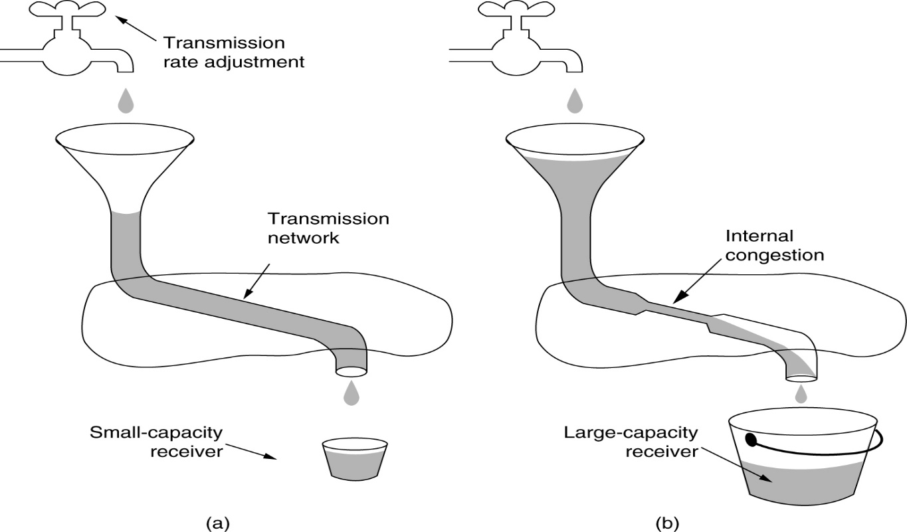
TCP Congestion Control
(a) A fast network feeding a low capacity receiver.
(b) A slow network feeding a high-capacity receiver.
CN211 CIVE 2018/19

Slide 49
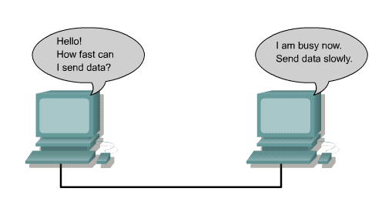
TCP Congestion Control
CN211 CIVE 2018/19

Slide 50
Congestion Window
In addition to receiver’s buffer information, the sender also maintains a congestion window.
This is mainly due to the fact that even if receiver may have space for fast data transfer, network may not carry it due to congestion.
The number of bytes to be sent is the minimum of the two windows (sender’s window and receiver’s window).
CN211 CIVE 2018/19

Slide 51
Windowing
  Windowing is a flow control mechanism requiring that the source device receive an acknowledgment from the destination after transmitting a certain amount of data.
  With a window size of three, the source device can send three octets to the destination.
  It must then wait for an acknowledgment.
  If the destination receives the three octets, it sends an acknowledgment to the source device, which can now transmit three more octets.
CN211 CIVE 2018/19

Slide 52
Windowing..
  If, for some reason, the destination does not receive the three octets, possibly due to overflowing buffers, it does not send an acknowledgment.
  Because the source does not receive an acknowledgment, it knows that the octets should be retransmitted and that the transmission rate should be slowed.
CN211 CIVE 2018/19

Slide 53
Window Size
Window size determines the amount of data that can be transmitted at one time before receiving an acknowledgment from the destination.
After a host transmits the window-sized number of bytes, the host must receive an acknowledgment that the data has been received before it can send any more data.
For example, with a window size of 1, each individual segment must be acknowledged before sending the next segment.
CN211 CIVE 2018/19

Slide 54
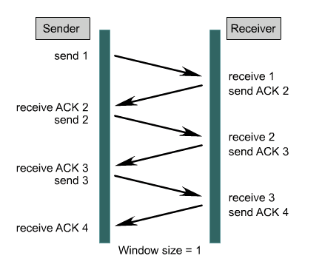
Windowing and Window Size
CN211 CIVE 2018/19

Slide 55
Sliding Window
TCP utilizes a sliding window when determining transmission size.
A sliding window allows for devices to negotiate a window size to allow for more than one byte to be sent during a single transmission.
This sliding window also allows the destination device to indicate to the source a need to decrease or increase the amount of data being sent because it is incapable at that time of dealing with that much data.
CN211 CIVE 2018/19

Slide 56
Sliding Window..
The size of the window is the lesser of receiver’s window and sender’s window.
The source does not have to send a full window’s worth of data.
The window can be opened or closed by the receiver, but should not be shrunk.
The destination can send an acknowledgment at any time as long as it does not result in a shrinking window.
The receiver can temporarily shut down the window; the sender, however, can always send a segment of 1 byte after the window is shut down.
CN211 CIVE 2018/19

Slide 57
Sliding Window..
What is the value of the receiver window (rwnd) for host A if the receiver, host B, has a buffer size of 5000 bytes and 1000 bytes of received and unprocessed data?
Solution
  The value of rwnd = 5000 − 1000 = 4000. Host B can receive only 4000 bytes of data before overflowing its buffer. Host B advertises this value in its next segment to A.
  What is the size of the window for host A if the value of rwnd is 3000 bytes and the value of sender’s window (cwnd) is 3500 bytes?
  Solution
  The size of the window is the smaller of rwnd and cwnd, which is 3000 bytes.
CN211 CIVE 2018/19

Slide 58
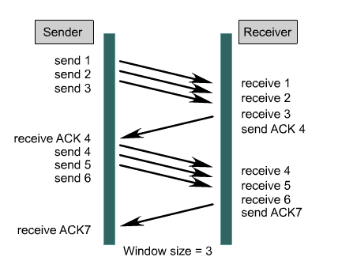
Sliding Window..
CN211 CIVE 2018/19

Slide 59
Sequencing Numbers
TCP applies sequence numbers to the data segments it is transmitting so that the receiver will be able to properly reassemble the bytes in their original order.
Sequencing numbers indicate to the destination device the correct order in which to put the bytes when they are received.
These sequencing numbers also act as reference numbers so that the receiver will know if it has received all of the data.
They also identify the missing data pieces to the sender so it can retransmit the missing data.
CN211 CIVE 2018/19

Slide 60
Sequencing Numbers..
This offers increased efficiency since the sender only needs to re-transmit the missing segments instead of the entire set of data.
The value in the sequence number field of a segment defines the number assigned to the first data byte contained in that segment.
The value of the acknowledgment field in a segment defines the number of the next byte a party expects to receive.
  The acknowledgment number is cumulative.
Read about Kevin Mitnick and Predictable Sequence numbers: https://course.ccs.neu.edu/cs6740/Lectures/Lecture-7.pdf
CN211 CIVE 2018/19

Slide 61
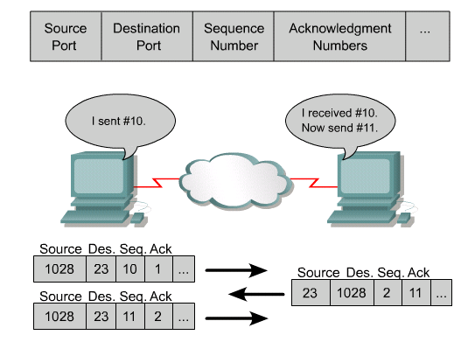
CN211 CIVE 2018/19

Slide 62
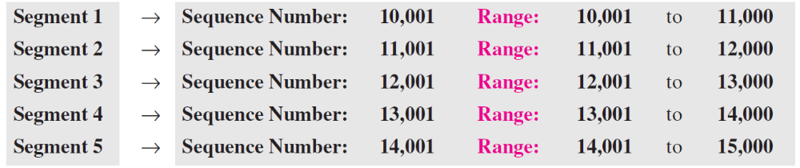
Sequencing Numbers..
Suppose a TCP connection is transferring a file of 5,000 bytes. The first byte is numbered 10,001. What are the sequence numbers for each segment if data are sent in five segments, each carrying 1,000 bytes?
Solution:
  The following shows the sequence number for each segment:
CN211 CIVE 2018/19

Slide 63
Protecting against Wraparound
Relevance of the 32-bit sequence number space.
The sequence number used on a given connection might wraparound.
A byte with sequence number x could be sent at one time, and then at a later time a second byte with the same sequence number x could be sent.
Packets cannot survive in the Internet for longer than the Maximum Segment Lifetime (MSL).
MSL is set to 120 sec.
We need to make sure that the sequence number does not wrap around within a 120-second period of time.
Depends on how fast data can be transmitted over the Internet.
CN211 CIVE 2018/19

Slide 64
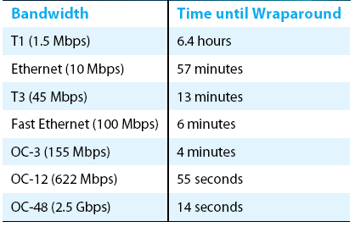
Protecting against Wraparound..
CN211 CIVE 2018/19

Slide 65
Positive ACK
  Acknowledgement is a common step in the synchronization process which includes sliding windows and data sequencing.
  TCP utilizes positive acknowledgment and retransmission to control data flow and confirm data delivery.
  Positive acknowledgment and retransmission (PAR) is a common technique many protocols use to provide reliability.
  With PAR, the source sends a packet, starts a timer, and waits for an acknowledgment before sending the next packet.
  If the timer expires before the source receives an acknowledgment, the source retransmits the packet and starts the timer over again.
CN211 CIVE 2018/19

Slide 66
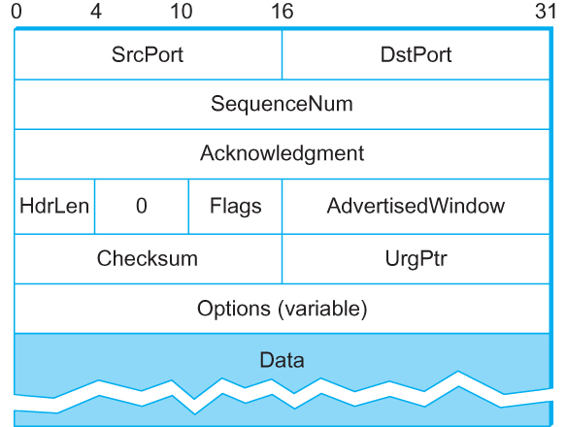
TCP Header
TCP Header Format
CN211 CIVE 2018/19

Slide 67
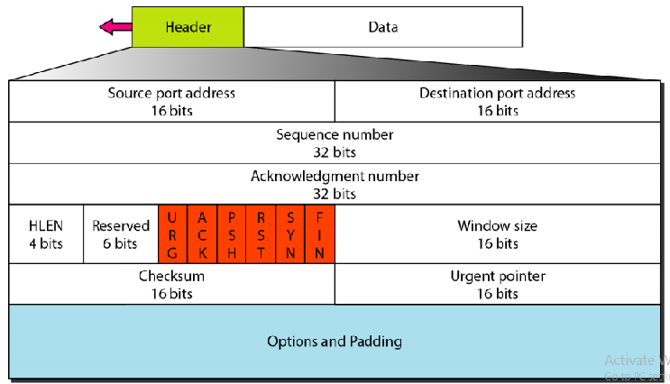
TCP Header-Types of Flags
CN211 CIVE 2018/19

Slide 68
TCP Header..
Source port address: This is a 16-bit field that defines the port number of the application program in the host that is sending the segment.
Destination port address: This is a 16-bit field that defines the port number of the application program in the host that is receiving the segment.
Sequence number: This 32-bit field defines the number assigned to the first byte of data contained in this segment.
CN211 CIVE 2018/19

Slide 69
TCP Header..
Acknowledgment number. This 32-bit field defines the byte number that the receiver of the segment is expecting to receive from the other party.
  If the receiver of the segment has successfully received byte number x from the other party, it returns x + 1 as the acknowledgment number.
  Header length.This 4-bit field indicates the number of 4-byte words in the TCP header.
  The length of the header can be between 20 and 60 bytes.
  Therefore, the value of this field is always between 5 (5* 4= 20) and 15 (15 * 4= 60).
CN211 CIVE 2018/19

Slide 70
TCP Header..
Reserved. This is a 6-bit field reserved for future use.
Flags. This field defines 6 different control bits or flags:
  URG: is contained at the front of the segment body, up to and including a value of UrgPtr bytes into the segment.
  ACK: is set any time the Acknowledgment field is valid, implying that the receiver should pay attention to it.
  PSH: Push the data. This flag signifies that the sender invoked the push operation, which indicates to the receiving side of TCP that it should notify the receiving process of this fact.
CN211 CIVE 2018/19

Slide 71
TCP Header..
Flags. This field defines 6 different control bits or flags:
  SYN: Synchronize sequence numbers. It is used when establishing a TCP connection.
  RST: Reset the connection. This flag signifies that the receiver has become confused, it received a segment it did not expect to receive—and so wants to abort the connection.
  FIN: Terminate the TCP connection.
CN211 CIVE 2018/19

Slide 72
TCP Header..
Window size. This field defines the window size of the sending TCP in bytes.
  Note that the length of this field is 16 bits, which means that the maximum size of the window is 65,535 bytes.
Checksum. This 16-bit field contains the checksum. It is computed over the TCP header, the TCP data, and the pseudoheader, which is made up of the source address, destination address, and length fields from the IP header.
Urgent pointer. This 16-bit field, which is valid only if the urgent flag is set, is used when the segment contains urgent data.
CN211 CIVE 2018/19

Slide 73
Synchronization or 3-way handshake
This is a three-step process that establishes the virtual connection between the two devices.
  First, one host initiates a connection by sending a synchronization (SYN) packet indicating its initial sequence number of x with a certain bit in the header set to indicate a connection request. This bit is set in the acknowledgment number field of the TCP header (also referred to as the code field).
  Second, the other host receives the packet, records the sequence number of x, replies with an acknowledgment of x + 1, and includes its own initial sequence number of y. The acknowledgment number of x + 1 means the host has received all octets up to and including x, and is expecting x + 1 next.
  Finally, the initiating host responds with a simple acknowledgment (ACK) of y + 1 (host B’s sequence number + 1), indicating it received the previous ACK which finalizes the connection process.
CN211 CIVE 2018/19

Slide 74
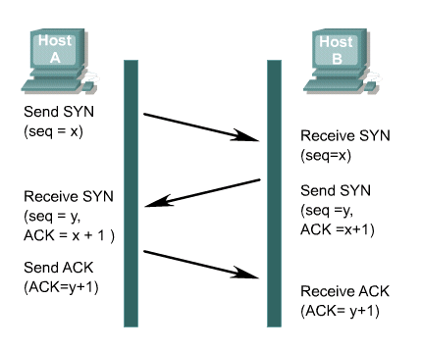
Synchronization or 3-way handshake...
CN211 CIVE 2018/19

Slide 75
Denial of Service Attacks
Denial of service (DoS) attacks are designed to deny services to legitimate hosts attempting to establish connections.
DoS attacks are a common method that hackers utilize to halt system response.
One type of DoS is known as SYN flooding.
SYN flooding exploits the normal three-way handshake and causes targeted devices to ACK to source addresses that will not complete the handshake.
CN211 CIVE 2018/19

Slide 76
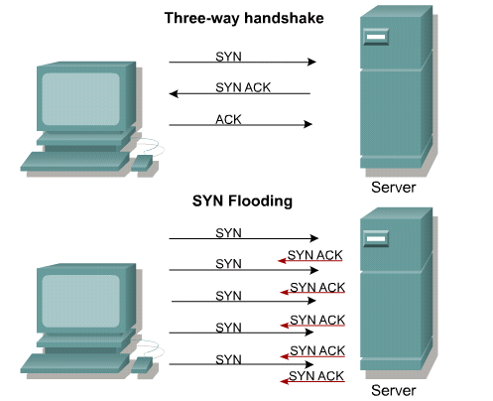
Denial of Service Attacks ..
CN211 CIVE 2018/19

Slide 77
Hacker’s Use of TCP
  Hackers will mangle packets to confuse target systems.
  A confused system can give up information, provide access or even stop responding.
  Some of the common Tricks:
  Setting no flags or all flags
  Attempt to connect using the handshake but not complete it. This will provide a fast way to enumerate ports.
  Setting strange combos of Flags may reveal what OS we are dealing with. (Fingerprinting)
  Send a packet with the ACK flag set can get past some simple firewall systems.
CN211 CIVE 2018/19

Slide 78
Example of Lab Work and Tutorial
  The following is a dump of a TCP header in hexadecimal format.
  05320017 00000001 00000000 500207FF 00000000
  a. What is the source port number?
  b. What is the destination port number?
  c. What is the sequence number?
  d. What is the acknowledgment number?
  e. What is the length of header?
  f. What is the type of segment?
  g. What is the window size?
CN211 CIVE 2018/19

Slide 79
Similarities Between TCP and UDP
  Both protocols ensure interface to the higher layer-application protocols by transmitting the data coming into the host to the appropriate applications.
  Both use the idea of port and socket.
  Both support interface to the underlying Network IP layer by encapsulating their PDUs into IP packets.
  Both protocol entities are installed only on end nodes.
CN211 CIVE 2018/19

Slide 80
Differences Between TCP and UDP
Criteria | TCP | UDP
Connection | Connection-oriented | Connectionless
Ordering of packets | Rearranges packets in the order specified | No inherent order as packets are independent of each other
Speed of transfer | Slower than UDP | Faster because there is no connection establishment and error checking.
CN211 CIVE 2018/19

Slide 81
Differences Between TCP and UDP..
Criteria | TCP | UDP
Reliability | There is guarantee that data transferred will remain intact and in the same order it was sent | No guarantee that the messages or packets will reach the destination at all
Header size | 20 Bytes | 8 Bytes
Streaming of Data | Data is read as a byte stream | Packets are sent individually
CN211 CIVE 2018/19

Slide 82
Differences Between TCP and UDP..
Criteria | TCP | UDP
Data Flow Control | TCP does Flow Control. TCP requires three packets to set up a socket connection | UDP does not have an option for flow control
Acknowledgement | Acknowledgement segments | No Acknowledgment
CN211 CIVE 2018/19

